Slide 1
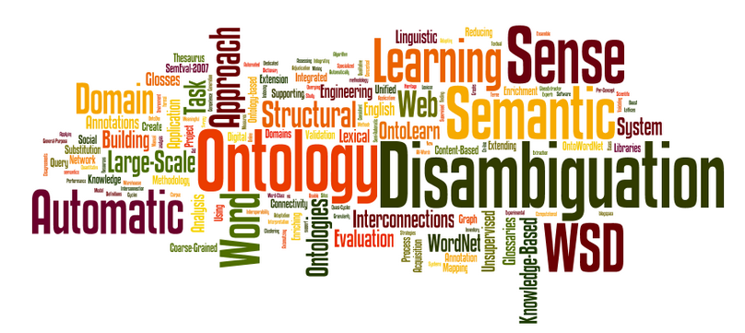
Topic 11 (Part 1) Text Analytics & Sentiment Analysis

Slide 2
Sentiment Analysis: Definition
The computational field of study that analyzes people’s opinions, sentiments, evaluations, appraisals, attitudes, and emotions towards entities such as products, services, organizations, individuals, issues, events, topics, and their attributes expressed in text (Liu, 2012).

Slide 3
Sentiment Analysis: Definition
Using NLP, statistics, or machine learning methods to extract, identify, or otherwise characterize the sentiment content of a text unit
Also known as opinion mining
Represents a large problem space

Slide 4
What is Sentiment?
An assumption on a binary opposition in opinions
For/against, like/dislike, good/bad, etc.
Some sentiment analysis jargons:
“Semantic orientation”
“Polarity”

Slide 5

Sentiment Analysis
Sentiment analysis determines the attitude or inclination of a communicator through the contextual polarity of their speaking or writing
May be based on :
own judgment
emotional state of subject
state of any emotional communication that affects a reader or listener
Subjective impressions, not facts

Slide 6
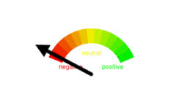

Sentiment Analysis
Tries to determine and classify a person’s state of mind on a subject matter
Information can be mined/extracted from texts, tweets, blogs, chats, social media sources, news articles or comments

Slide 7
Interesting Questions in SA
Is this product review positive or negative?
Is this customer email satisfied or dis-satisfied?
Based on a sample of tweets, how are people responding to this ad campaign/product release/news item?
How have bloggers' attitudes about the election?

Slide 8

Different Levels of Analysis
Document level
Classify whether a whole opinion document expresses a positive or negative sentiment.
Assumes that each document expresses opinions on a single entity (e.g., a single product)
Example: product review

Slide 9
Different Levels of Analysis
Sentence level
Determines whether each sentence expressed a positive, negative, or neutral opinion.
Distinguishes sentences (objective sentences) that express factual information from sentences (subjective sentences) that express subjective views and opinions
Example:
“We bought the car last month and the windshield wiper has fallen off” (objective sentence)
“Apple is doing very well in this lousy economy” (subjective sentence + opinion)

Slide 10
Different Levels of Analysis
Entity and Aspect level
Aspect level performs finer-grained analysis, also known as feature level
Directly looks at the opinion itself based on the idea that an opinion consists of a sentiment (positive or negative) and a target (of opinion)
Example (1): “I absolutely love what apple did with iPhone15. Slightly more curved edges, dynamic island, matte finish on the back, 48mp camera, usb-c, amazing colors, It’s just so perfect. I am also still just blown away by the 15 pro. It looks and seem AWESOME!
Evaluates SIX aspects, edges, island, finishing, camera, usb and colors of iPhone15 (entity)
Sentiment (positive): dynamic, matte, 48mp, amazing, love, perfect, blown away, awesome

Slide 11
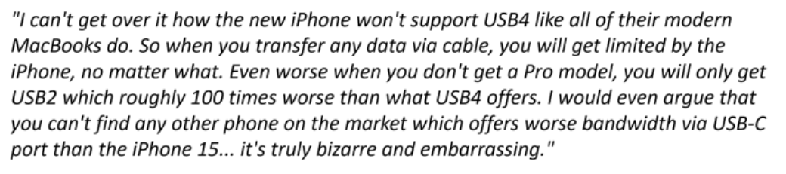
Different Levels of Analysis
Example (2):
Evaluates SIX aspects: data transfer, bandwidth, and port of iPhone15 (entity)
Sentiment (negative): won’t support, limited, worse, bizarre, embarrassing

Slide 12
Sentiment Analysis Lexicon
There seems to be some relation between positive words and positive reviews
We can come up with a set of keywords by hand to identify polarity
Positive words: love, best, cool, great, good, amazing, helpful, awesome, perfect
Negative words: hate, worst, awful, nightmare, fail, embarrassing, awful
Neutral words: unusual, confusing, not bad, perhaps, possible, probably
Neutral usually means no opinion or words do not fall in either category

Slide 13

Customer Reviews on Airline Services (airline ratings.com & X(twitter))
“Those #AmericanAirlines losers canceled my flight!”
I will never book with AirAsia X again. I had my scheduled flights cancelled on the 31st August and have been waiting ever since for my refund.
Dear United baggage crew, please deliver my luggage. Let my luggage be found.
I recently travelled on Malaysia Airlines from Sydney to KL. Everything was good and the service was excellent.
We had a very bad experience from Qatar airways and crew. we already complained to Qatar airways and the reply we got from them was really disappointing

Slide 14
Challenges in SA
People express opinions in complex ways
In opinion texts, lexical content alone can be misleading
Intra-textual and sub-sentential reversals, negation, topic change are common
Rhetorical devices/modes such as sarcasm, irony, implication, etc.

Slide 15
Steps in Sentiment Analysis using NLTK Manual Training/Testing
Train classifier to automatically classify a tweet as a positive or negative tweet using NLTK.
Need a list of manually classified tweets (training data: labelled) and unclassified tweets (test data: unlabelled). Examples:
Classified tweets (training)
Positive tweets
I like this laptop.
The view here is fantastic.
I feel great tonight.
I am very excited about the class project.
He is my best friend.
Negative tweets
I hate this laptop.
The view here is awful.
I feel tired tonight.
I am not looking forward to the class project.
He is my worst friend ever.
Unclassified tweets (testing)
Positive/Negative tweets?
I feel happy this morning.
Hussin is my friend.
I do not like that guy.
My car is not great.
Your tweet is annoying.

Slide 16
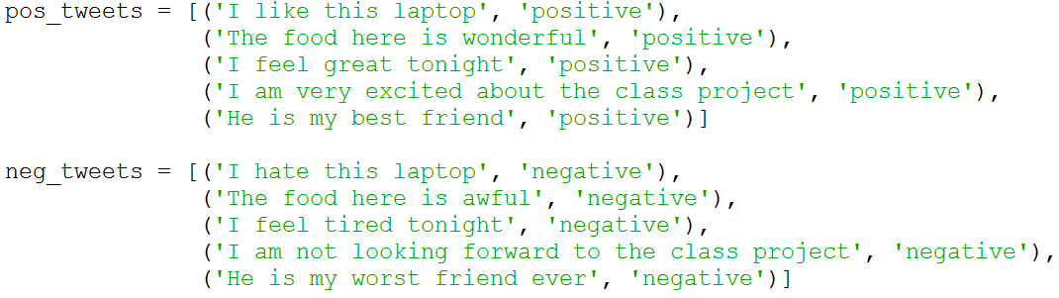
Steps in Sentiment Analysis using NLTK
Import nltk
Create two separate lists in Python for positive and negative tweets:

Slide 17
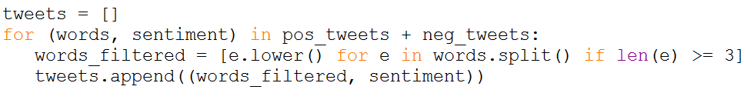
Steps in Sentiment Analysis using NLTK
Take both lists and create a single list of tuples each containing two elements (merge list into a tuple). First element is an array containing the words and second element is the type of sentiment.
Set a property for extraction: Exclude words smaller than 2 characters and normalize tweets by setting all words in lowercase .

Slide 18
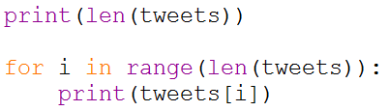
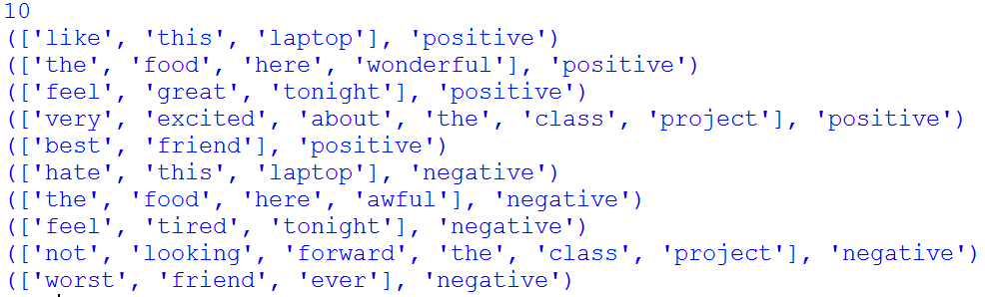
Steps in Sentiment Analysis using NLTK
Print the new merged list of tweets in the tuple

Slide 19
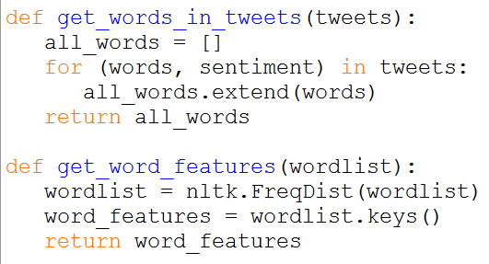
Steps in Sentiment Analysis using NLTK
Extract word features from the tweets (this is Bag of Words feature extraction method).
This is a list with every distinct words ordered by frequency of appearance.
Use the following function to get the list plus the two NLTK helper functions.

Slide 20
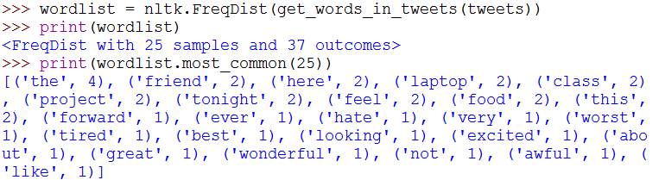
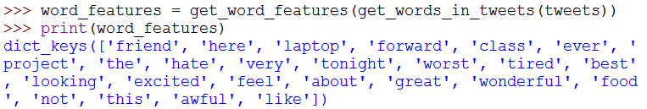
Steps in Sentiment Analysis using NLTK
Looking into variable ‘wordlist’ of the function get_word_features() :
List of word_features:

Slide 21
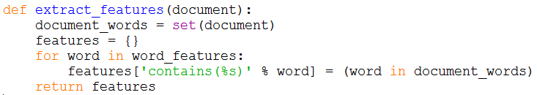
Steps in Sentiment Analysis using NLTK
To create a classifier, we need to decide what features are relevant.
We first need a feature extractor which returns a dictionary indicating what words are contained in the input passed (tweets).
Use the previously extracted word features list with the input to create the dictionary.

Slide 22
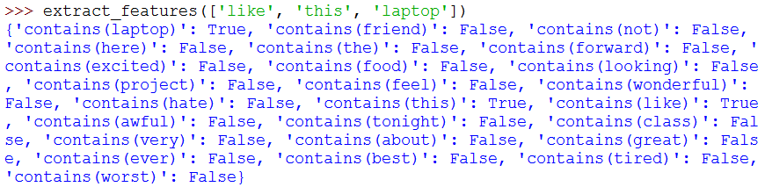
Steps in Sentiment Analysis using NLTK
Call the feature extractor with the document [‘like’, ‘this’, ‘laptop’] which is the first positive tweet.
We obtain the following dictionary which indicates that the document contains the words: ‘like’, ‘this’ and ‘laptop’.
This is a boolean word feature extractor

Slide 23
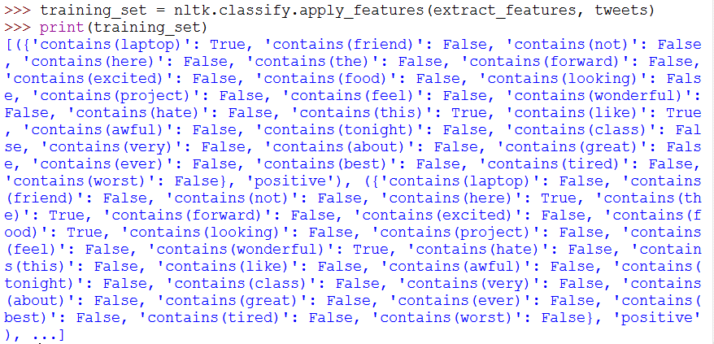
Training the Classifier with NLTK
Using our feature extractor, we apply the features to our classifier using the method apply_features()
Pass the feature extractor along with our tweets list

Slide 24
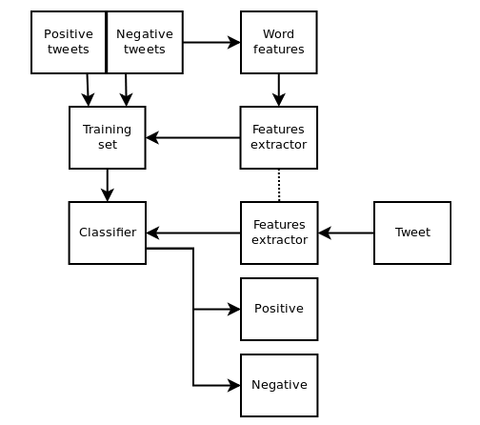
Training the Classifier with NLTK (cont.)
We train our classifier with our training set:

Slide 25
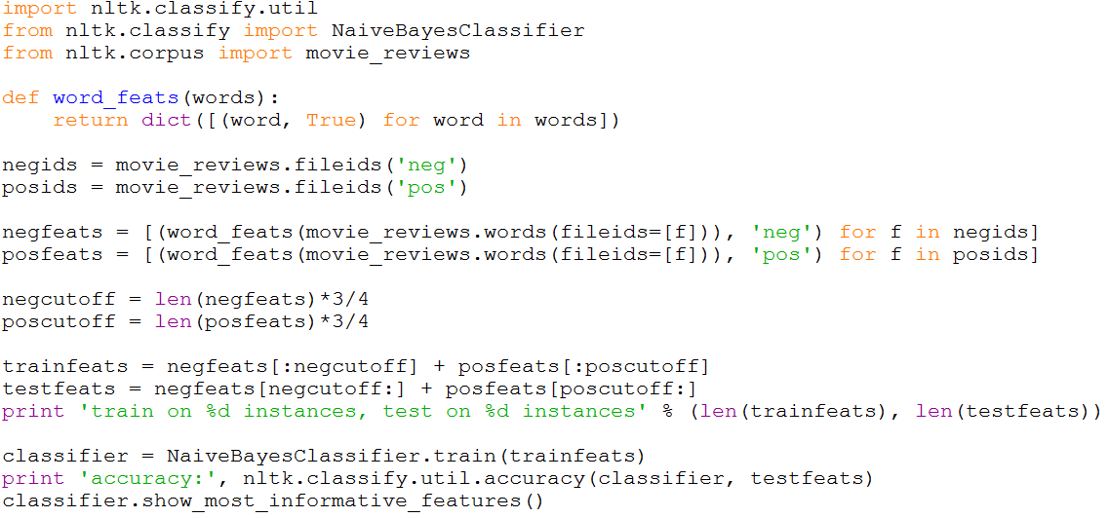
Example for NLTK Movie Reviews

Slide 26
Sentiment Analysis Evaluation
The use of sentiment lexicon/word list to determine polarity of sentiment (positive and negative words)
Simple Summarization Score
Assign +1 to positive sentiment
Assign -1 to negative sentiment
Assign 0 to neutral sentiment
Accumulate score for each sentence:
Positive total = +ve sentiment
Negative total = -ve sentiment
Zero total = neutral sentiment

Slide 27
Pointwise Mutual Information (PMI)
Information-theory approach to find collocations
Measure of how much one word tells us about the other. How much information we gain?
Can be negative or positive
Can be used with n-gram language model

Slide 28
Pointwise Mutual Information : Intuition
Similar to Bayesian Modeling
Given two events, x’ and y’
In this case x’ and y’ are occurrences of particular words (a sentiment and some other words)
Denominator P(x) * P(y) is the expected value of P(x , y), assuming x and y are independent

Slide 29
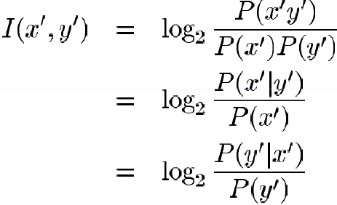
Pointwise Mutual Information

Slide 30
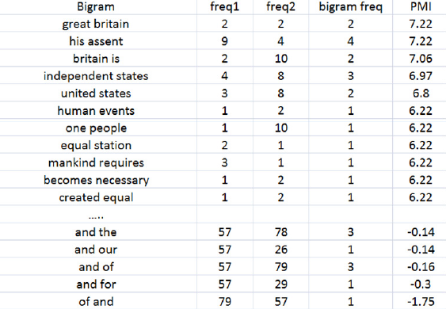
Examples with PMI (Bigram)

Slide 31
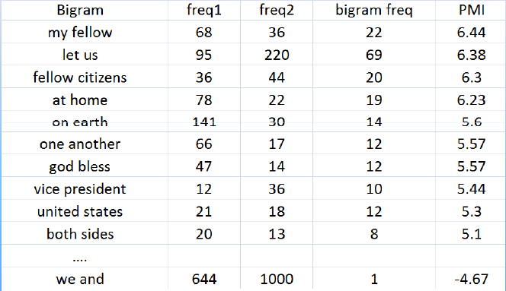
Examples with PMI (Bigram)

Slide 32
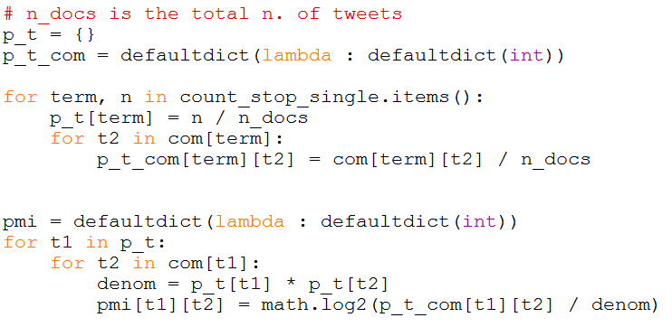
Examples with PMI: Calculating Probabilities

Slide 33
Problems with PMI
Bad with sparse data
Words that only occur once, but appear together may get very high score PMI score
High PMI score might not necessarily indicate importance of bigram

Slide 34
Other sources of Sentiment Analysis
SentiWordNet
http://sentiwordnet.isti.cnr.it/
A lexical resource for opinion mining
Based on Wordnet synsets
Each synset is assigned three sentiment scores: positivity, negativity, and objectivity

Slide 35
Chat Analytics using Telegram data
https://towardsdatascience.com/introduction-to-the-telegram-api-b0cd220dbed2
https://medium.com/@jiayu./telegrammetry-stats-for-telegram-dcd075376f56
https://medium.com/@chodvadiyasaurabh/automating-data-collection-and-analysis-from-telegram-groups-using-python-and-telethon-8d51e194fa8b
https://medium.com/@ishitagopal/collecting-messages-from-telegram-using-telegrams-api-and-python-5d7e4a9286b2
https://medium.com/@chodvadiyasaurabh/automating-data-collection-and-analysis-from-telegram-groups-using-python-and-telethon-8d51e194fa8b

